Slide 1
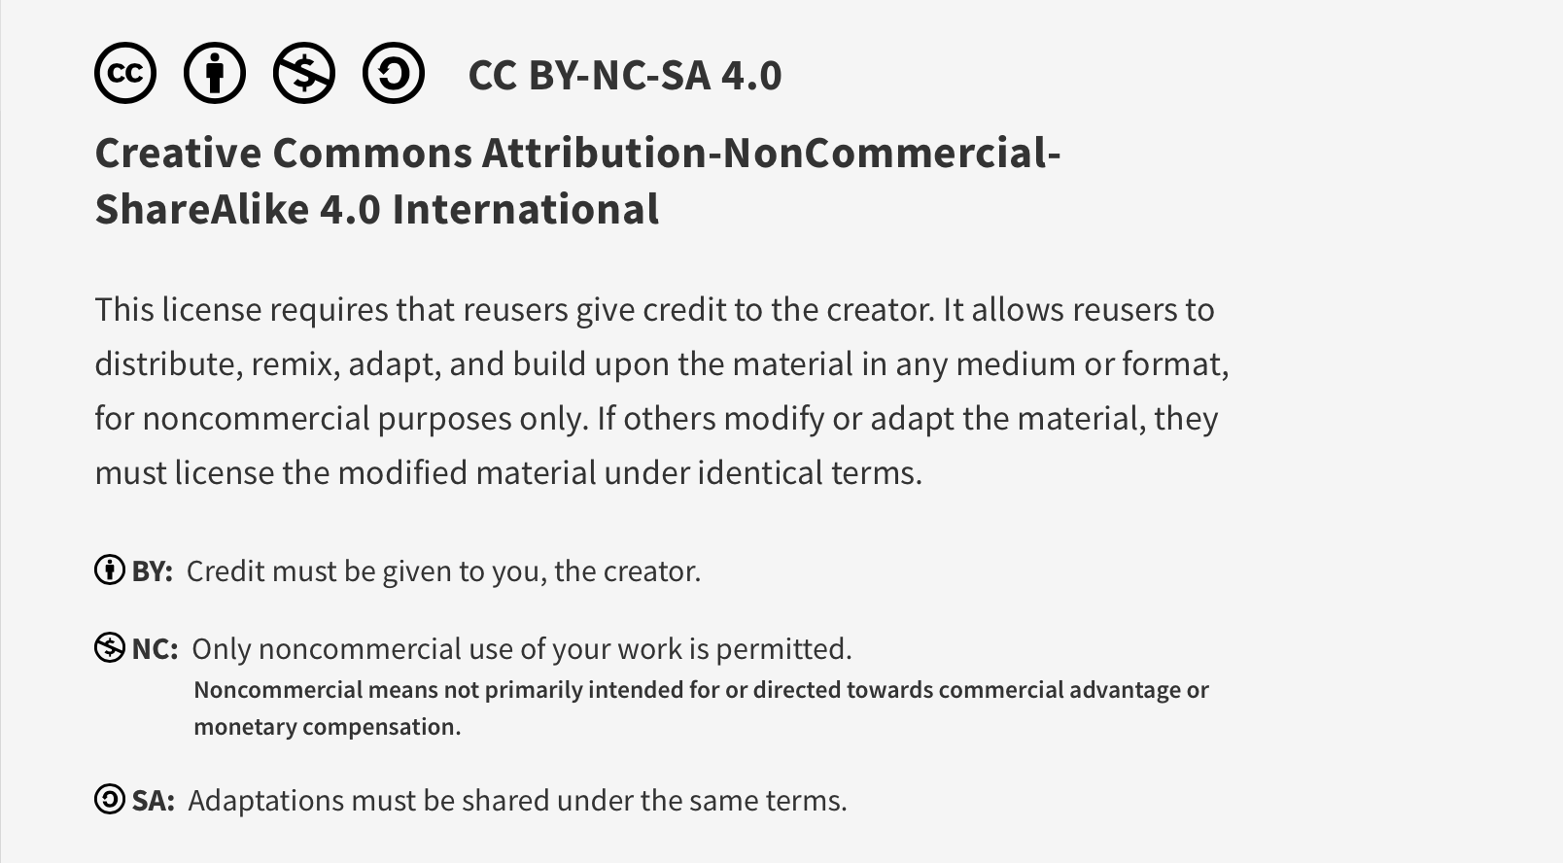
This work is licensed under CC BY-NC-SA 4.0. To view a copy of this license, visit: https://creativecommons.org/licenses/by-nc-sa/4.0/

Slide 2
Introduction to Quality Improvement 1 Core program session
Lucie Filteau, MD, FRCPC
PGY 2-4 AHD
QPS Lecture series

Slide 3
Ottawa Anesthesia QPS Curriculum
PGY 1
PGY 2-4
Intro to Safety
Handover
Stress and Substance Abuse
IPAC Session
Positioning Workshop
Intro to Quality Improvement 1
Intro to Quality Improvement 2
Systems Thinking and Design
Human Factors
Resource Stewardship
Situational Awareness, Teamwork and Communication

Slide 4
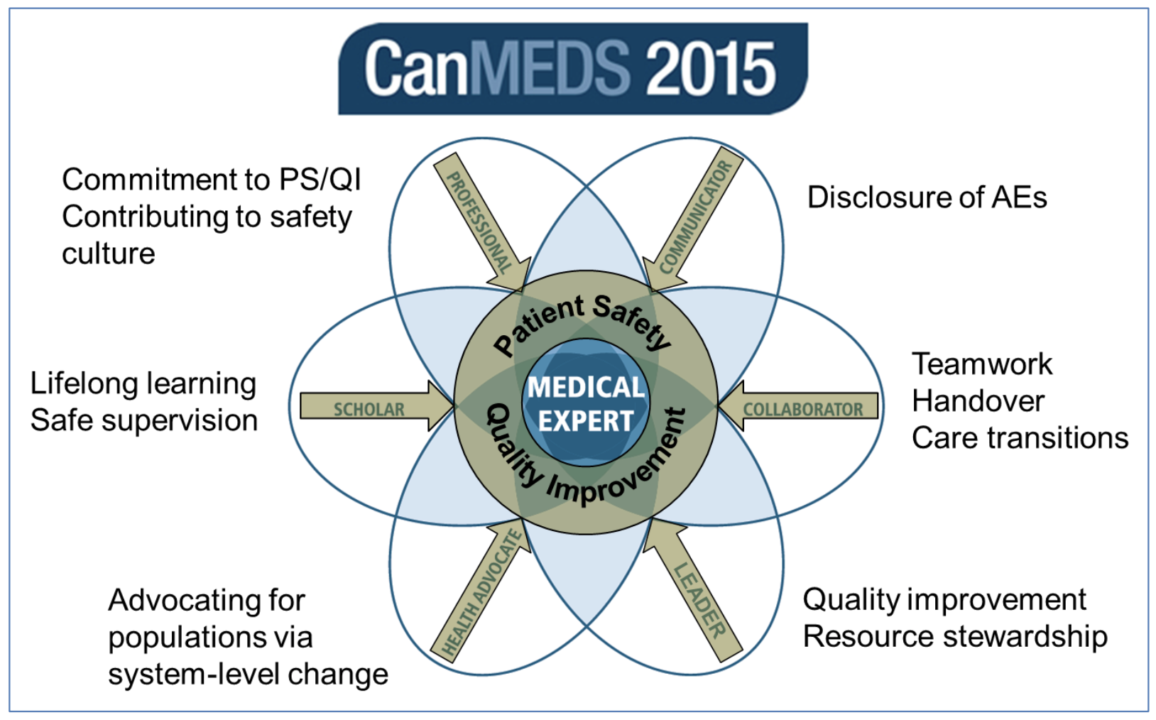
Why are we learning this?
Royal College CanMEDS Roles
Created 1996, updated 2005, 2015
2015 CanMEDS update
New objectives/competencies in
Patient Safety
Quality Improvement
Resource Stewardship
New provincial mandates for QI
Also: because it’s important!

Slide 5

Pre-session material
Questions/comments on material?
Canadian healthcare stats
Domains of quality
QI vs research

Slide 6
Exercise on Quality Domains
Create a list of 1-2 anesthesia/periop specific examples of quality improvement initiatives in each of the quality domains.
Individual work: 10-15 mins
Followed by group discussion

Slide 7
Domains of Quality to Consider
Safety: free from harm
Timeliness: minimizes wait time for care
Effectiveness: evidence based, achieves desired outcome
Efficiency: minimizes resource waste
Equity: accessible regardless of age/gender/ethnicity/SES
Person-centeredness: individuals’ goals, wishes respected
Planetary health: minimizes environmental impact
Healthcare worker wellness: improves HCW sustainability

Slide 8
Physician Scorecards
You are a group of leaders within your anesthesia department. Your hospital introduced an electronic record last year. The hospital administration has recently informed you that each department will need to establish quality indicators for departmental and individual performance assessments.
Small group discussion: what you think should be included? Create a list of specific indicators to share. (10-15 mins)

Slide 9
Discussion of Performance Indicators
What would you include on the scorecard?

Slide 10
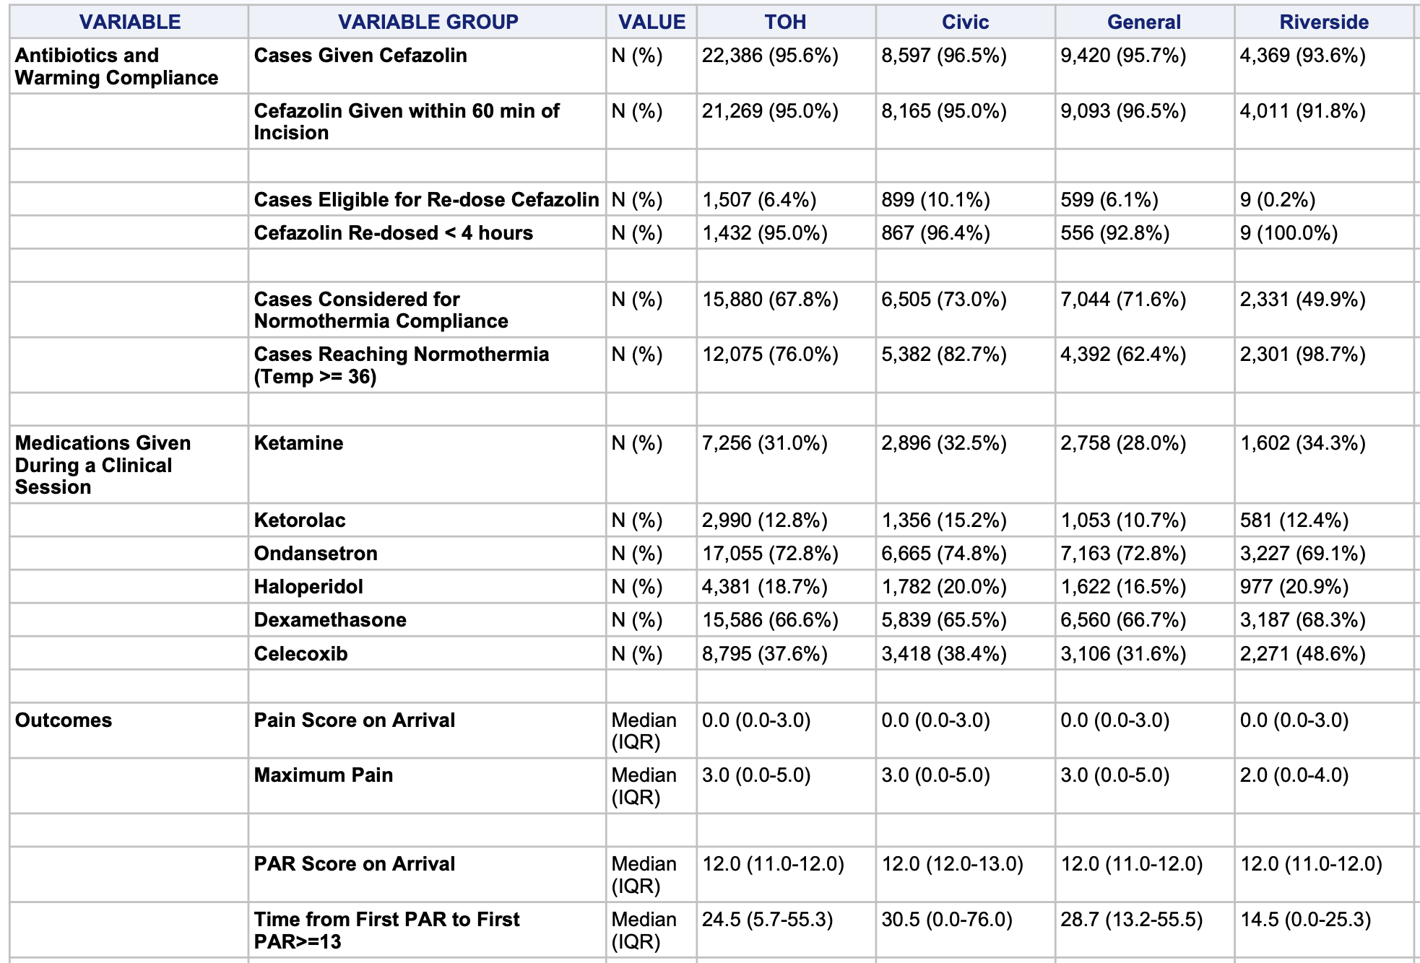

Slide 11
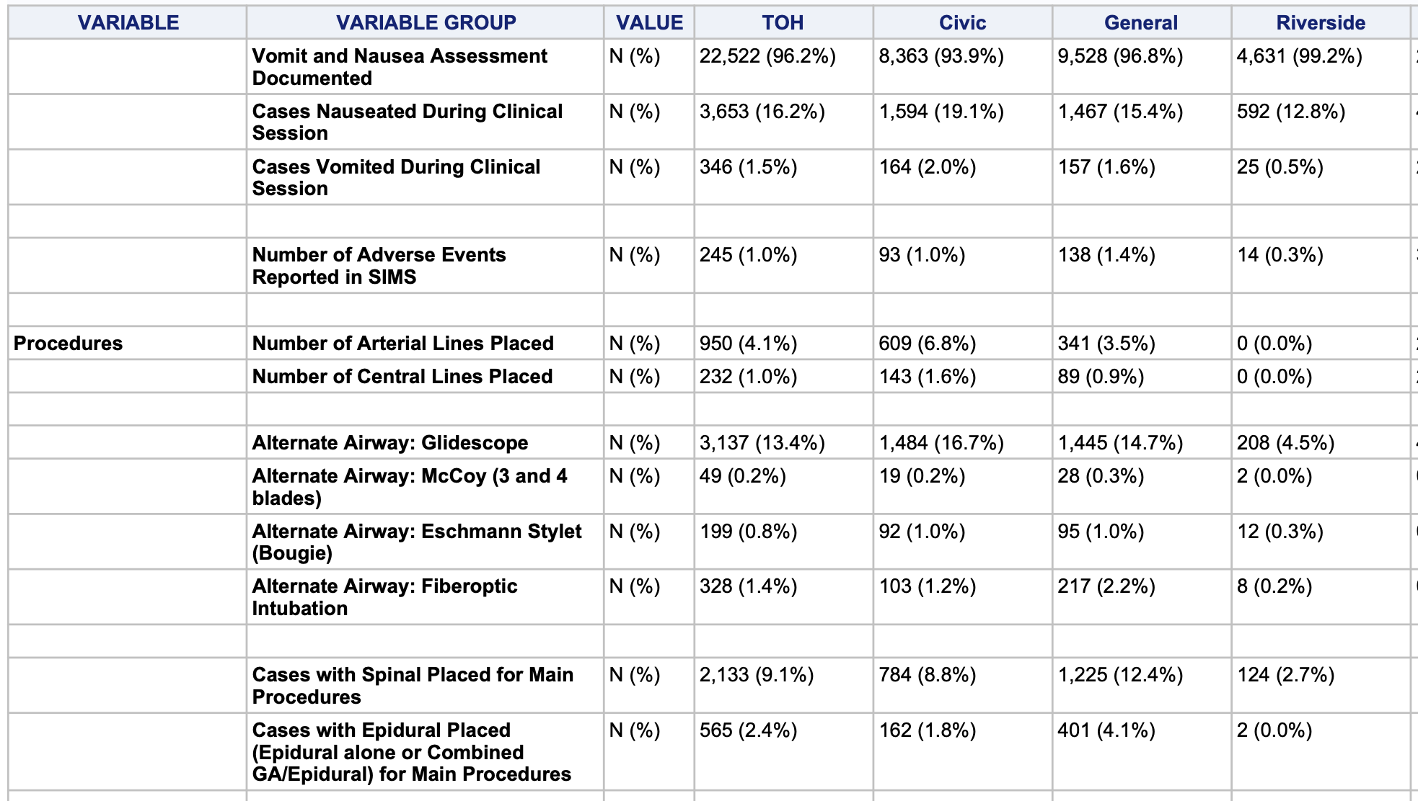

Slide 12
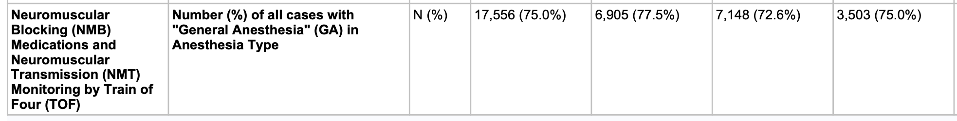
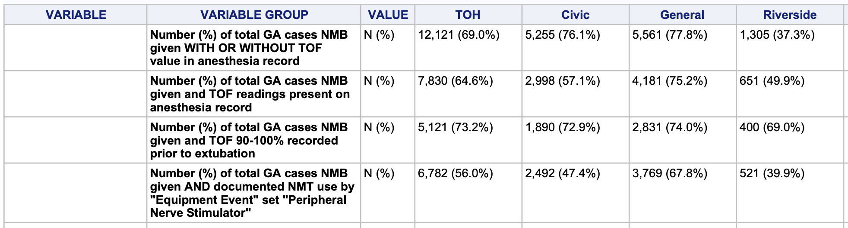

Slide 13
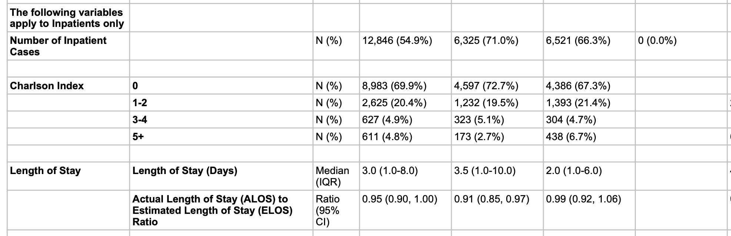

Notes:
Charlson Comorbidity Index: predicts risk of death within 1 year
Looks at 22 medical conditions, assign a (variable) score for each present.
Clinical conditions and associated scores are as follows:
1 each: Myocardial infarct, congestive heart failure, peripheral vascular disease, dementia, cerebrovascular disease, chronic lung disease, connective tissue disease, ulcer, chronic liver disease, diabetes.
2 each: Hemiplegia, moderate or severe kidney disease, diabetes with end organ damage, tumor, leukemia, lymphoma.
3 each: Moderate or severe liver disease.
6 each: Malignant tumor, metastasis, AIDS.

Slide 14
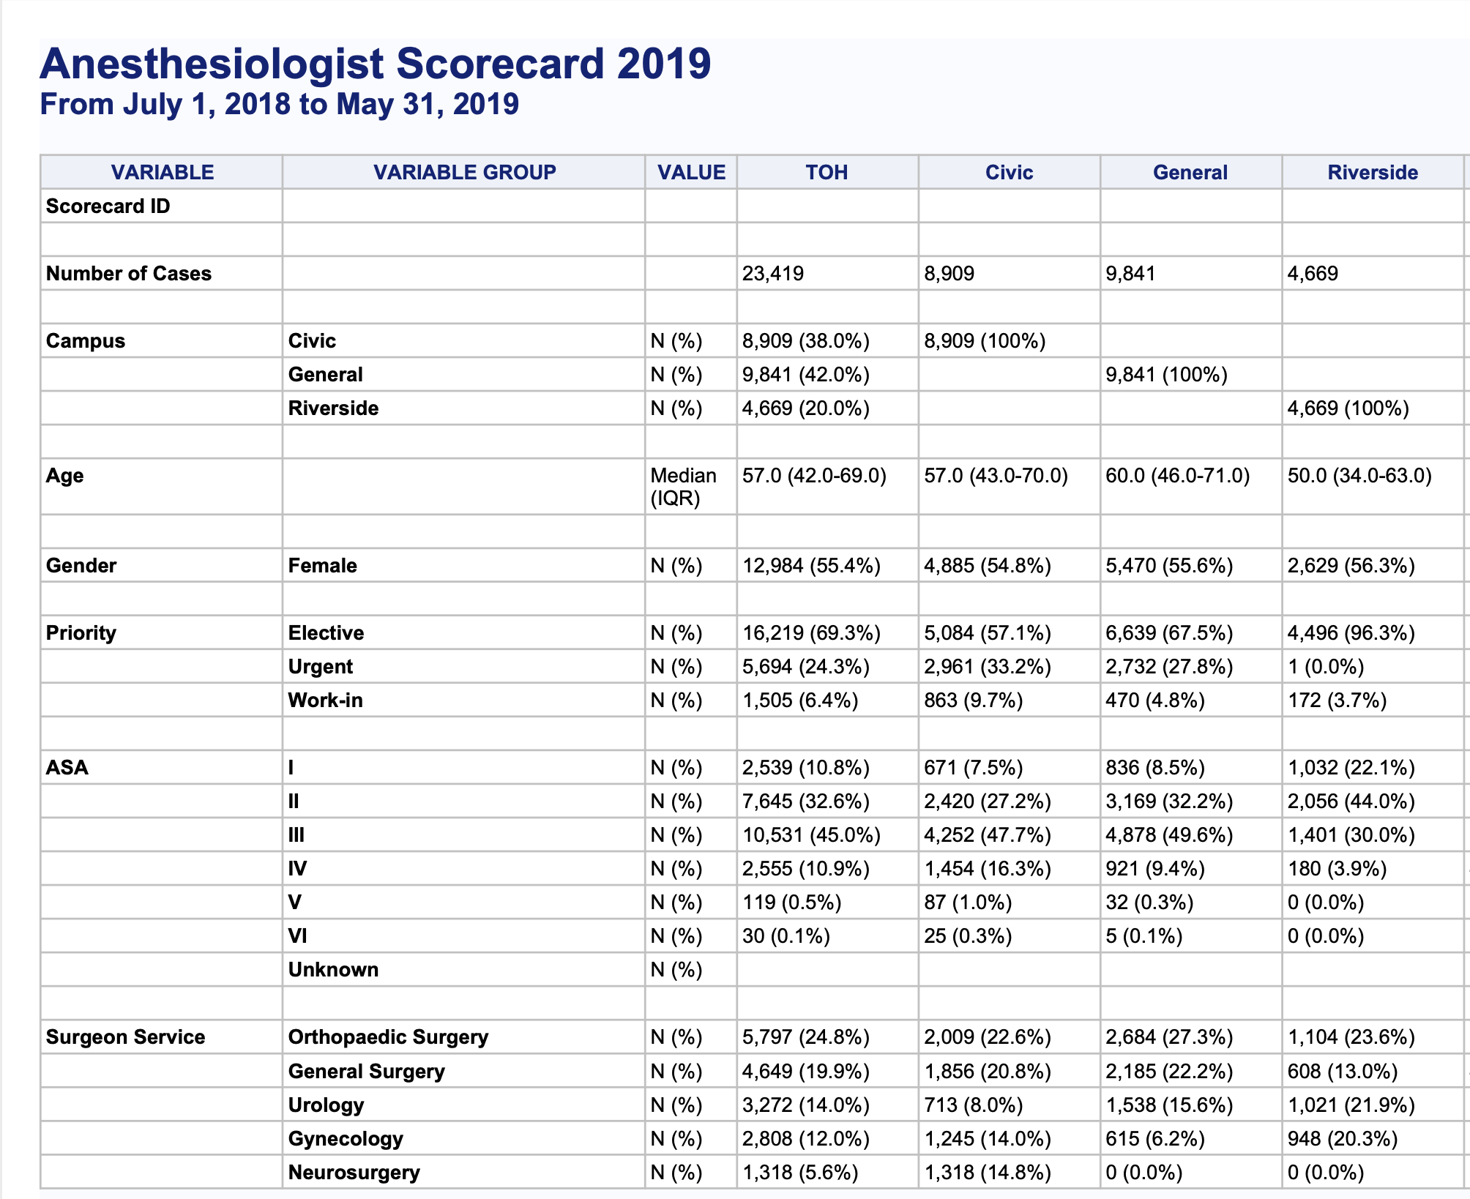

Slide 15
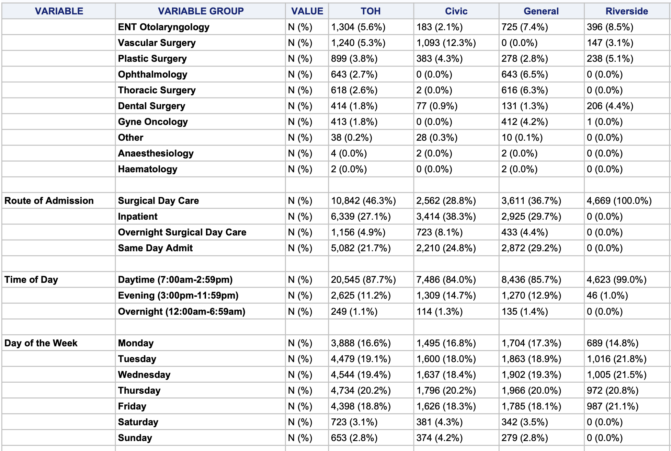

Slide 16
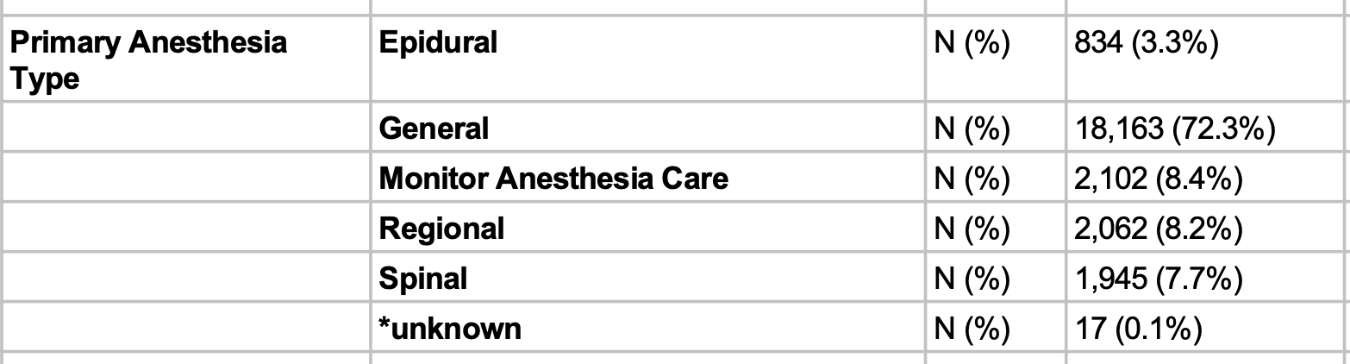

Slide 17
Discussion of Performance Indicators
What challenges do you anticipate?
How would you manage the results?

Slide 18
Challenges
Variation (comparing apples to oranges)
Differing subspecialties
Differing patient populations
Inaccurate data
Quality of charting
Intentional data fudging
Handling of results
Data anonymized or not?
Share anonymized/full data with dept leadership? Hospital? Province? Public?
Consequences to data?
Peer shaming? Impact on employment? Impact on income?

Slide 19
Positive Deviance
Solutions to a problem are setting specific
In any given setting with its many constraints, some individuals consistently manage to have better outcomes with the same resources.
Focusing on their behaviours brings insight to others
Scorecards: look at and share/promote habits of TOP scorers (rather than focusing on and criticizing low performers)

Slide 20
Questions?

Slide 21
This work is licensed under CC BY-NC-SA 4.0. To view a copy of this license, visit: https://creativecommons.org/licenses/by-nc-sa/4.0/

